Slide 1



Session Title: Median Session No.: $02$ Course Name: Probability and statistics Course Code: C1UC322T

Slide 2
Reflect on the responses of post session activity
Imagine a marathon with 100 runners. If we arrange their finishing times in order, which time would best represent the ‘middle’ performance?

Slide 3
At the end of this session students will be able to At the end of this lesson, students will be able to
Learning Outcomes
Compute the median for grouped and ungrouped data
Interpret its significance in data distribution.

Slide 4
Session Outline
1 Introduction to Median
2
3 Calculate median for grouped data
4 Wrap up and Reflection
Calculate median for Ungrouped
data

Slide 5
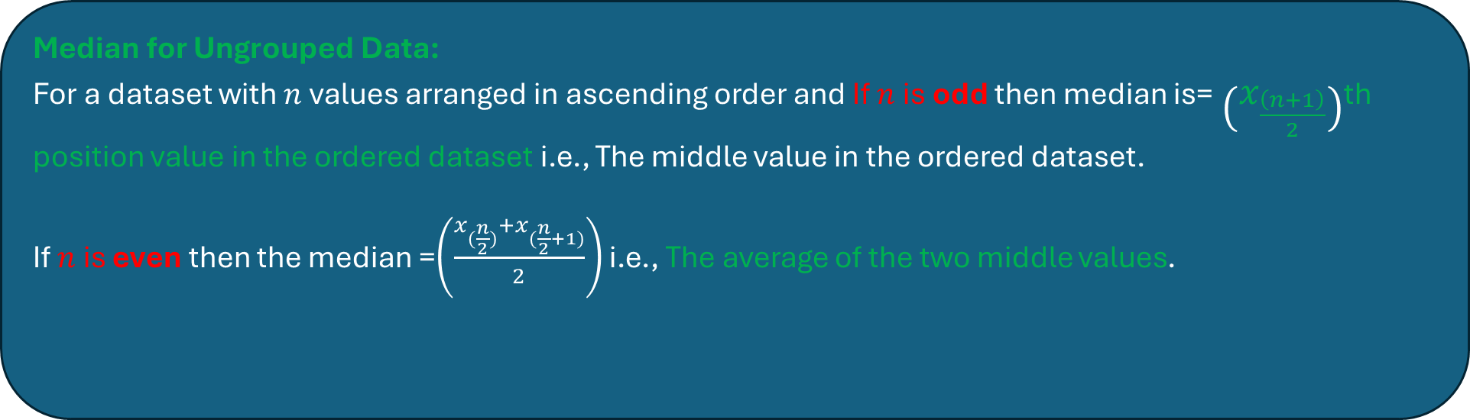
Median
Definition: The median is the middle value of a dataset when arranged in ascending or descending order.
It represents the central tendency of the data and is less affected by extreme values compared to the mean.
Median for Ungrouped Data:
For a dataset with $n$values arranged in ascending order and If $n$ is odd then median is=$\left(x_{\frac{\left(n+1\right)​}{2}}\right)$th position value in the ordered dataset​ i.e., The middle value in the ordered dataset.
If $n$ is even then the median =$\left(\frac{x_{(\frac{n}{2})}+x_{(\frac{n}{2}+1)}}{2}\right)$ i.e., The average of the two middle values.

Slide 6
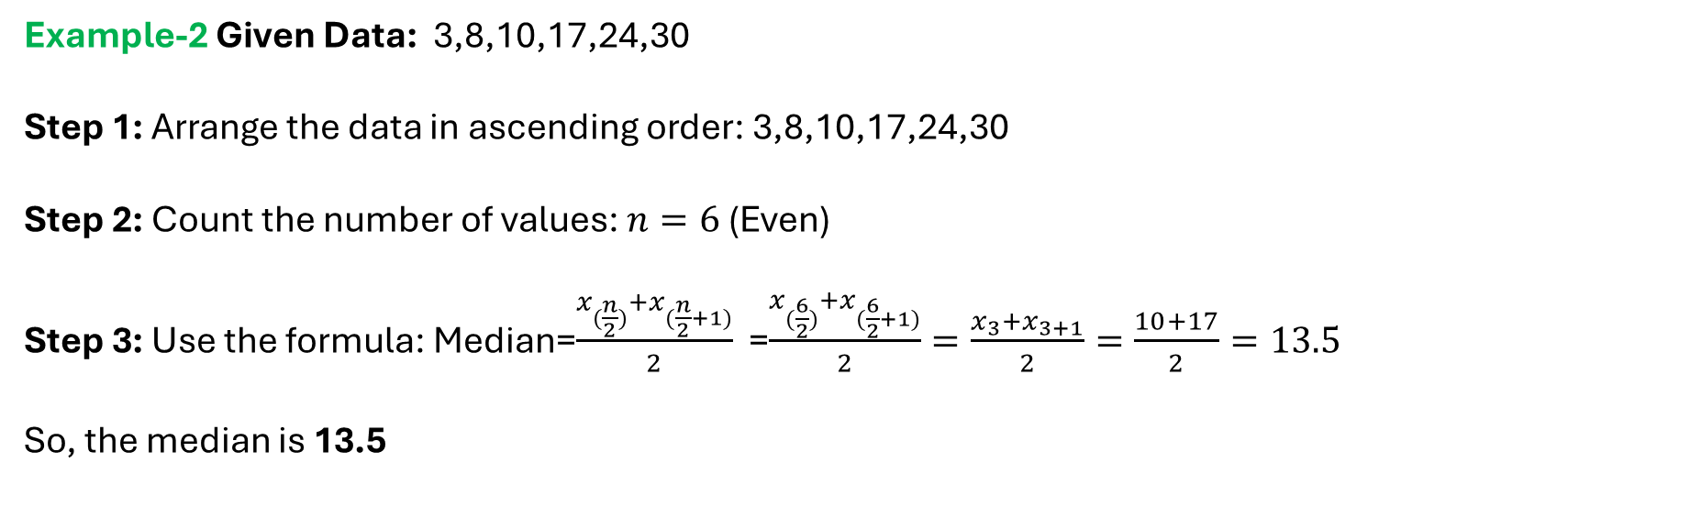
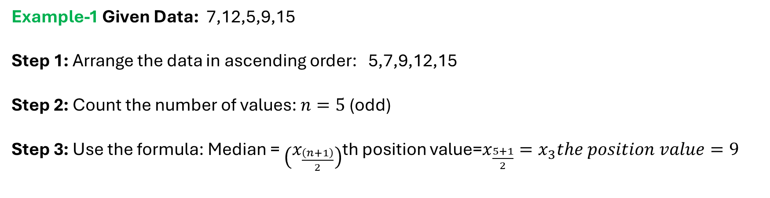
Examples
Example-1 Given Data: 7,12,5,9,15
Step 1: Arrange the data in ascending order: 5,7,9,12,15
Step 2: Count the number of values: $n=5$(odd)
Step 3: Use the formula: Median = $\left(x_{\frac{\left(n+1\right)​}{2}}\right)$th position value=$x_{\frac{5+1}{2}}=x_{3}the position value=9$
Example-2 Given Data: 3,8,10,17,24,30
Step 1: Arrange the data in ascending order: 3,8,10,17,24,30
Step 2: Count the number of values: $n=6$(Even)
Step 3: Use the formula: Median=$\frac{x_{(\frac{n}{2})}+x_{(\frac{n}{2}+1)}}{2}$ =$\frac{x_{(\frac{6}{2})}+x_{(\frac{6}{2}+1)}}{2}=\frac{x_{3}+x_{3+1}}{2}=\frac{10+17}{2}=13.5$
So, the median is 13.5

Slide 7
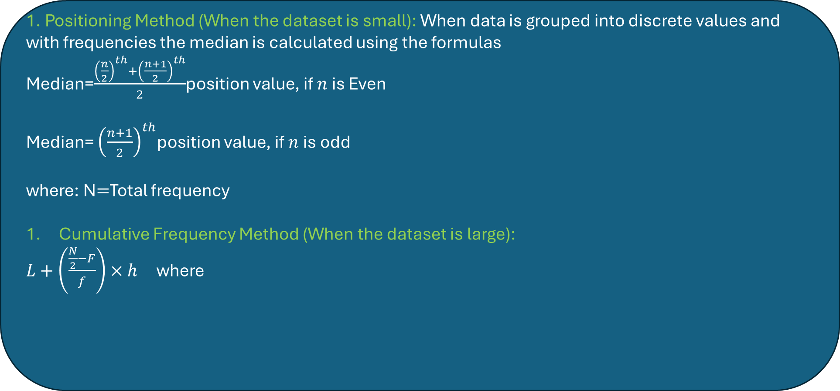

Median for grouped data
Discrete data with frequency
1. Positioning Method (When the dataset is small): When data is grouped into discrete values and with frequencies the median is calculated using the formulas
Median=$\frac{{\left(\frac{n}{2}\right)}^{th}+{\left(\frac{n+1}{2}\right)}^{th}}{2}$position value, if $n$ is Even
Median= ${\left(\frac{n+1}{2}\right)}^{th}$position value, if $n$ is odd
where: N$=$Total frequency
Cumulative Frequency Method (When the dataset is large):
$L+\left(\frac{\frac{N}{2}−F}{f}\right)×h$ where
$L=$Median class value i.e., The cumulative frequency just greater than $\frac{n}{2}$
N$=$Total frequency
$F=$Cumulative frequency before the median class value
$f=$Frequency of the corresponding median class value
$h=$Interval size

Slide 8
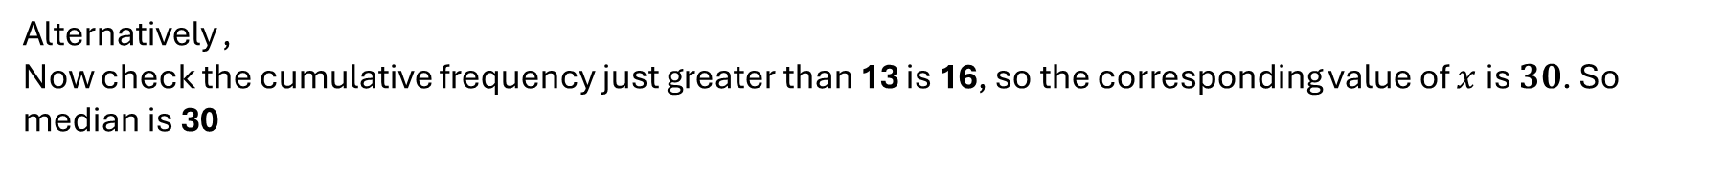
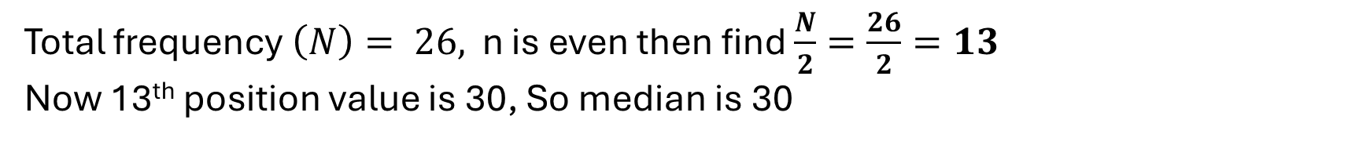
Let’s try an example
Example-1. Find the median of the following data.
values (x) | Frequency (f)
10 | 3
30 | 8
20 | 5
50 | 6
40 | 4
values (x) | Frequency (f)
10 | 3
20 | 5
30 | 8
40 | 4
50 | 6
C.f
3
8
16
20
26
Total frequency $\left(N\right)= 26,$ n is even then find $\frac{N}{2}=\frac{26}{2}=13$
Now 13th position value is 30, So median is 30
Alternatively ,
Now check the cumulative frequency just greater than 13 is 16, so the corresponding value of $x$is $30$. So median is 30

Slide 9
Activity-1 (Pen-paper)
A school principal wants to understand how long students take to reach school to assess the need for improved transportation services. The following data shows the travel time (in minutes) for a group of students:
Travel Time (minutes) | Number of Students (Frequency)
5 | 4
10 | 6
15 | 8
20 | 5
25 | 7
What does the median tell us about students’ travel time?
How would the median change if new students with very long or very short travel times joined?
What recommendations can be made to improve transportation?

Slide 10
Answer
The median travel time is 15 minutes, meaning half of the students take 15 minutes or less, while the other half take more than 15 minutes.
2. If students with very short travel times joined, the median might shift downward.
If students with very long travel times joined, the median might shift upward.
Unlike the mean, the median is less affected by extreme values, making it a reliable measure of
typical travel time.
3. If many students have travel times longer than 15 minutes, the school could:
Introduce new bus routes.
Adjust pick-up/drop-off locations.
Encourage carpooling or public transport options.

Slide 11
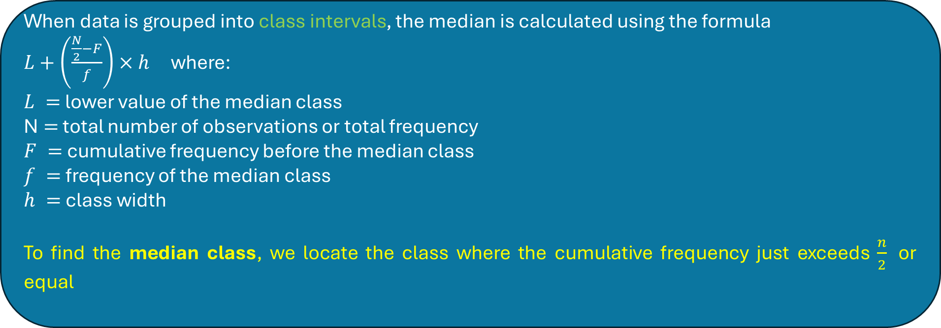
Median for grouped data
Continuous data i.e., in the class interval
When data is grouped into class intervals, the median is calculated using the formula
$L+\left(\frac{\frac{N}{2}−F}{f}\right)×h$ where:
$L =$lower value of the median class
N$=$total number of observations or total frequency
$F =$cumulative frequency before the median class
$f =$frequency of the median class
$h =$class width
To find the median class, we locate the class where the cumulative frequency just exceeds $\frac{n}{2}​$ or equal

Slide 12
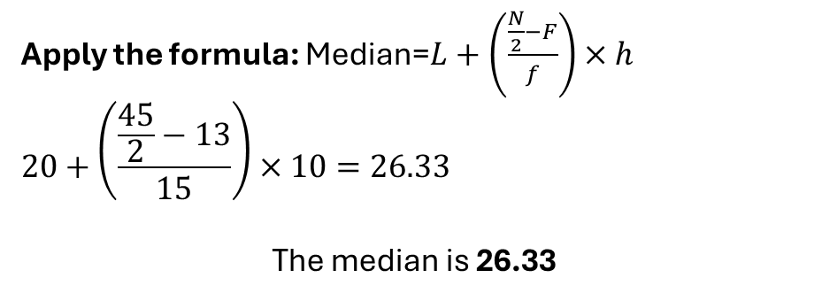
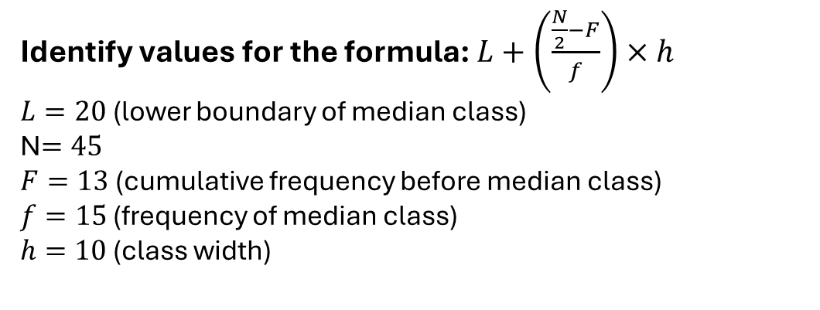
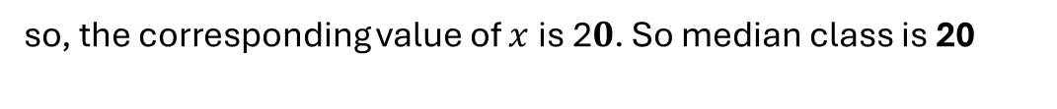
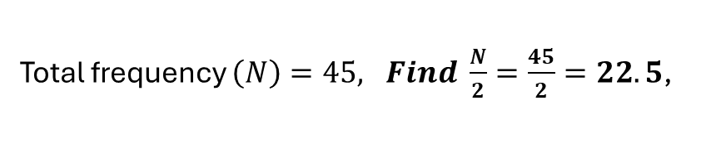
Example-1. Find the median of the following data.
Class interval (x) | Frequency (f)
0-10 | 5
10-20 | 8
20-30 | 15
30-40 | 10
40-50 | 7
C.f
5
13
28
38
45
Total frequency $\left(N\right)=45, Find \frac{N}{2}=\frac{45}{2}=22.5$,
Now check the cumulative frequency just greater than $\frac{N}{2}$=22.5 is 28
so, the corresponding value of $x$is 2$0$. So median class is 20
Apply the formula: Median=$L+\left(\frac{\frac{N}{2}−F}{f}\right)×h$
$$20+\left(\frac{\frac{45}{2}−13}{15}\right)×10=26.33$$
The median is 26.33
Identify values for the formula: $L+\left(\frac{\frac{N}{2}−F}{f}\right)×h$
$L=20$(lower boundary of median class)
N$=45$
$F=13$(cumulative frequency before median class)
$f=15$ (frequency of median class)
$h=10$(class width)

Slide 13
Activity-2 (Problem-Based Learning)
A company wants to determine the typical salary of its employees to make fair compensation decisions. They collect salary data from 50 employees and categorize it into a grouped frequency table:
Salary (₹1000s per month) | Number of Employees (Frequency f)
10-20 | 5
20-30 | 8
30-40 | 12
40-50 | 15
50-60 | 7
60-70 | 3
Q1. What does the median salary tell us about the company’s pay distribution?

Slide 14
Answers 1. It represents the typical salary at which half the employees earn less than ₹40,000 and half earn more than ₹40,000. 2. The median is not affected by outliers, unlike the mean. If a few employees earn very high salaries, the mean salary would be misleadingly high. 3. If some employees earned ₹100,000+, the mean salary would increase, but the median would remain stable, making it a better measure of the typical salary.

Slide 15
Assessment
Question: Find the median of the following frequency distribution

Slide 16
Exit Ticket:
"Give one real-life example where you think the median is more useful than the mean and explain why."

Slide 17
In the next lesson we will learn the concept of Mode for grouped data

